Slide 1

Text/Document Acquisition

Slide 2
We have been exploring the basic pipeline that is present in most NLP applications. But what does the pipeline start from?
Documents/Text of course!

Slide 3
In this topic we’ll have a look at different methods using which we can acquire text that we can process using NLP.
Pre-existing Corpora
Web Scraping
Transcription
OCR

Slide 4
Pre-existing Corpora
- A corpus is a large and structured set of machine-readable texts.
- Its plural is corpora.
They can be derived in different ways like text that was originally electronic, transcripts of spoken language and optical character recognition, etc.
- Using such files would simply mean reading text from a text file into the program
e.g. https://archive.ics.uci.edu/ml/datasets/sms+spam+collection

Slide 5
Web Scraping
- Some websites can contain a very large amount of invaluable data.
- Stock prices, product details, sports stats, company contacts, news, you name it.
- Web scraping refers to the extraction of data from a website.
Note: the act of web scraping isn't illegal. However, some rules need to be followed. Web scraping becomes illegal when non publicly available data becomes extracted.

Slide 6
Web Scraping
We can use these modules to web scrape using Python. These will help with HTML handling and parsing
beautifulsoup4
lxml

Slide 7
Web Scraping – getting page content
from bs4 import BeautifulSoup
from lxml import etree
import requests
URL = "https://www.euronews.com/culture"
webpage = requests.get(URL)
soup = BeautifulSoup(webpage.content, "html.parser")
print(str(soup)
After this, you can either use basic string processing to extract the parts you need, or use the xpath (see next slide)

Slide 8
Web Scraping – scraping
dom = etree.HTML(str(soup))
list = dom.xpath('//h2[contains(@id,"block_program_topstories_vertical_home")]//a//@title')
for element in list:
print(element)

Slide 9
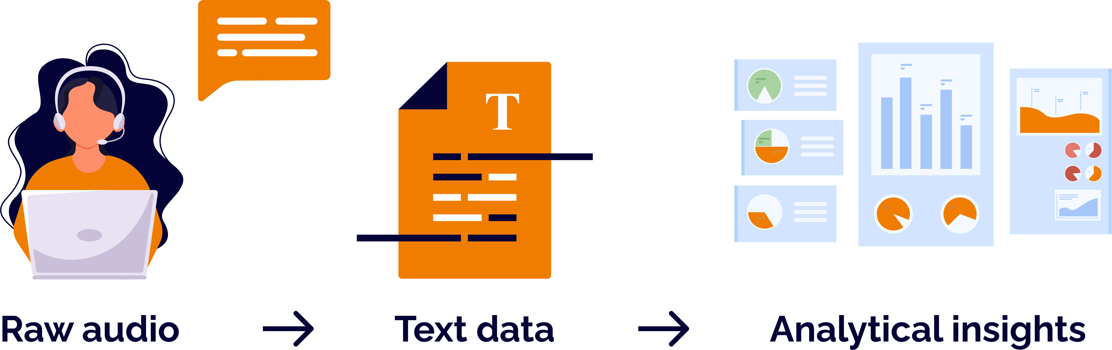
Transcription
Transcribing means converting from audio/video to text
This text can then be used in NLP

Slide 10
Transcription
We can use this module to transcribe using Python. This will help with audio to text conversion
SpeechRecognition

Slide 11
Transcription
import speech_recognition as sr
audio_file = "speaking.wav"
r = sr.Recognizer()
with sr.AudioFile(audio_file) as source:
audio = r.record(source) # read the entire audio file
print("Transcription: " + r.recognize_google(audio))

Slide 12
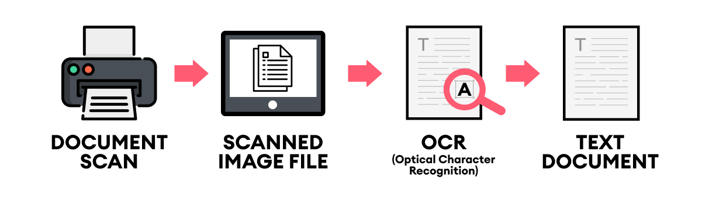
OCR
Optical Character Recognition
The process that converts an image of text into a machine-readable text format

Slide 13
OCR
We can use this module to do OCR using Python.
easyocr

Slide 14
OCR
import easyocr
reader = easyocr.Reader(['en'])
results = reader.readtext('testocr.png')
for (bbox, text, prob) in results:
# display the OCR'd text and associated probability
print(prob,"", text)

Slide 15
Applications
Try to think of a few NLP applications that can be done for each acquisition method we have covered

Slide 16
QUESTIONS
?

